Slide 1

OCTOBER 2023 OPTIONS INCOME
MASTERY
www.optionstradingiq.com
© Copyright. Options Trading IQ. All Rights reserved.

Slide 2
DISCLAIMER
Options Trading IQ Pty Ltd (ACN 658941612) is a Corporate Authorised Representative (001296496) of Network Influencer Pty Ltd (AFSL 282288) (trading as FZeroZero). Under these authorisations, Options Trading IQ is authorised to provide general financial product advice in respect of certain classes of financial products, which include securities and derivatives. Any financial product advice provided is general advice only and does not take into account your objectives, financial situation and needs. You should obtain investment advice from a licensed investment adviser before making any investment decisions. Options Trading IQ provides educational courses, this may include the supply of factual information and general advice about securities and derivatives products. Securities and Derivatives trading involves a high level of risk and may not be suitable for all investors. Past performance is not indicative of future results.
Any information contained in this presentation is for educational purposes only. Neither Options Trading IQ Pty Ltd or Gavin McMaster are licensed financial advisors, registered investment advisors, or registered broker dealers. Neither do they provide investment advice, financial advice or make investment recommendations and they are not in the business of transacting trades. Nothing in this communication constitutes a solicitation, recommendation, promotion, endorsement or offer to buy or sell by Options Trading IQ Pty Ltd or Gavin McMaster of any particular security, transaction or investment.
Any trades and / or results covered in this presentation may or may not be live trades.
All trades and trading results are believed to be accurately presented. However, since the trades may not have been executed in the market, the results may have been under or over compensated for the impact, if any, of certain market factors such as liquidity, slippage and commissions. Therefore there can be no guarantee of accuracy or completeness.
No representation is being made that any portfolio will, or is likely to achieve profits or losses similar to those shown.
The risk of loss in trading securities and options in particular can be substantial. Customers must consider all relevant risk factors, including their own personal financial circumstances, before making any financial transaction. Options involve risk and are not suitable for all investors. See the Options Disclosure Document: Characteristics and Risks of Standardized Options, available from www.optionstradingiq.com/risks
© Copyright. Options Trading IQ. All Rights reserved.

Slide 3
SESSION 2 REVIEW
Trading With Small Accounts
Delta Hedging
Case Study Update & New Case Studies
Volatility
Directional Credit Spreads
Iron Condors
© Copyright. Options Trading IQ. All Rights reserved.
3
Notes:
3

Slide 4
TODAY
Adjustments
Diagonals
Case Study Update
Calendars
Option Net Explorer
© Copyright. Options Trading IQ. All Rights reserved.
4
Notes:
4

Slide 5
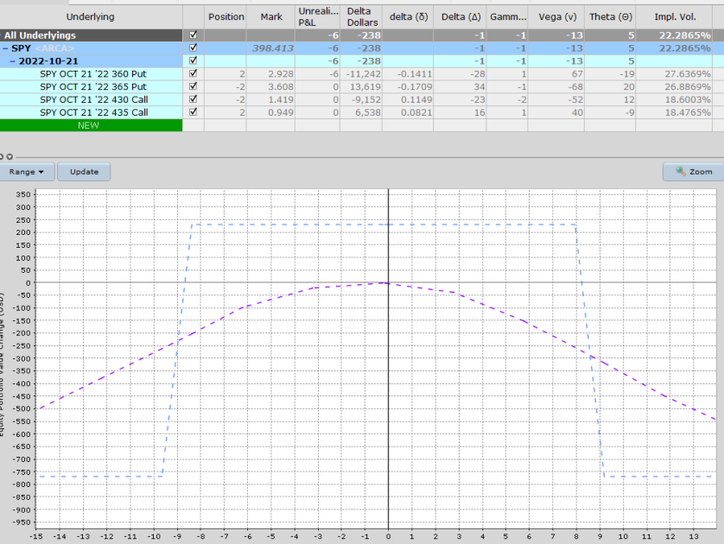
September 7th – Opening Position - SPY at 398.41
© Copyright. Options Trading IQ. All Rights reserved.
5
Notes:
5

Slide 6
September 21st – Adjustment - SPY at 374.92
Ideally, we want to adjust or hedge these when short delta hits 25, not 34. That being said, we talked about repositioning the entire condor and adding 1 extra contract.
The adjustment brings in a credit of around $80 and gets the trade back closer to delta neutral.
BEFORE:
© Copyright. Options Trading IQ. All Rights reserved.
6
Notes:
6

Slide 7
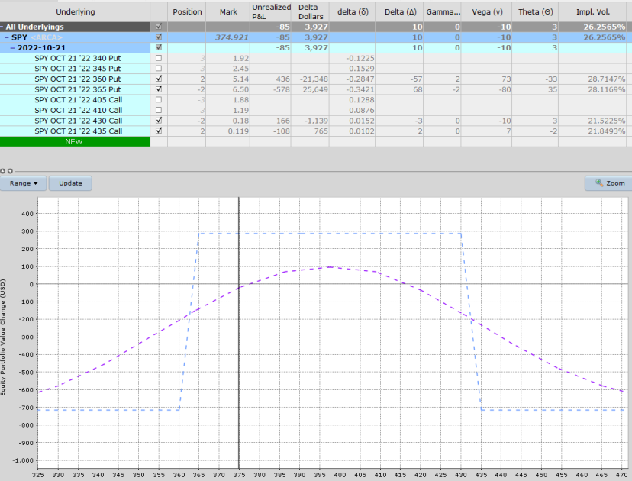
BEFORE:
© Copyright. Options Trading IQ. All Rights reserved.
7
Notes:
7

Slide 8
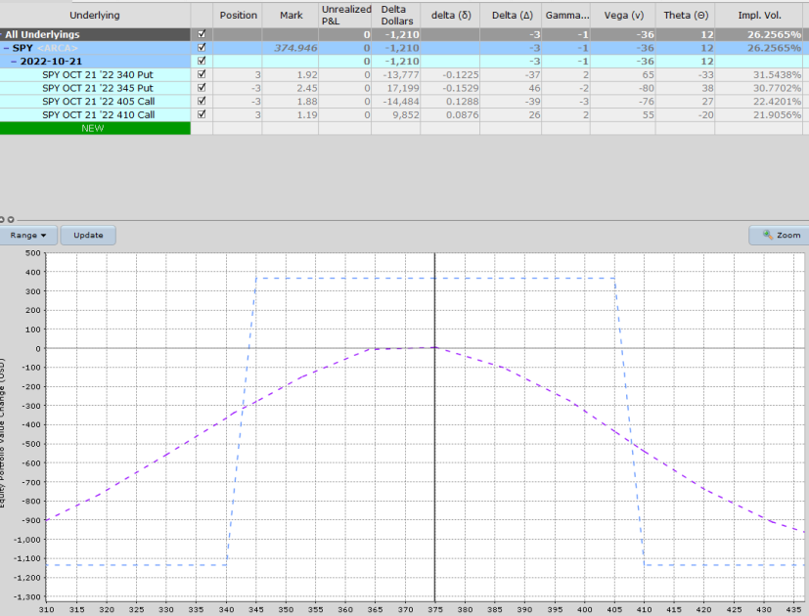
AFTER:
© Copyright. Options Trading IQ. All Rights reserved.
8
Notes:
8

Slide 9
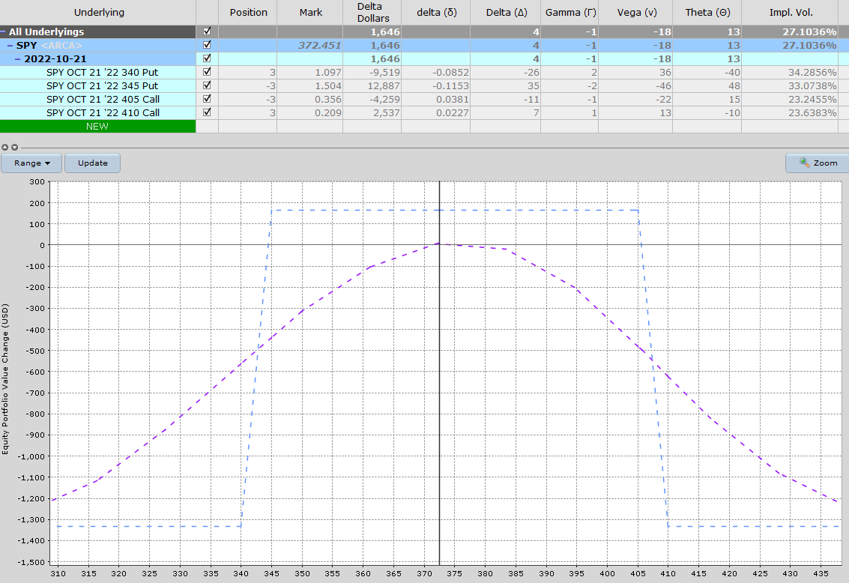
October 6th – Close Out - SPY at 372.45
Trade is looking pretty good and is +$155.
© Copyright. Options Trading IQ. All Rights reserved.
9
Notes:
9

Slide 10
THANK YOU!
www.optionstradingiq.com
© Copyright. Options Trading IQ. All Rights reserved.

