Slide 1

OCTOBER 2023 OPTIONS INCOME
MASTERY
www.optionstradingiq.com
© Copyright. Options Trading IQ. All Rights reserved.

Slide 2
DISCLAIMER
Options Trading IQ Pty Ltd (ACN 658941612) is a Corporate Authorised Representative (001296496) of Network Influencer Pty Ltd (AFSL 282288) (trading as FZeroZero). Under these authorisations, Options Trading IQ is authorised to provide general financial product advice in respect of certain classes of financial products, which include securities and derivatives. Any financial product advice provided is general advice only and does not take into account your objectives, financial situation and needs. You should obtain investment advice from a licensed investment adviser before making any investment decisions. Options Trading IQ provides educational courses, this may include the supply of factual information and general advice about securities and derivatives products. Securities and Derivatives trading involves a high level of risk and may not be suitable for all investors. Past performance is not indicative of future results.
Any information contained in this presentation is for educational purposes only. Neither Options Trading IQ Pty Ltd or Gavin McMaster are licensed financial advisors, registered investment advisors, or registered broker dealers. Neither do they provide investment advice, financial advice or make investment recommendations and they are not in the business of transacting trades. Nothing in this communication constitutes a solicitation, recommendation, promotion, endorsement or offer to buy or sell by Options Trading IQ Pty Ltd or Gavin McMaster of any particular security, transaction or investment.
Any trades and / or results covered in this presentation may or may not be live trades.
All trades and trading results are believed to be accurately presented. However, since the trades may not have been executed in the market, the results may have been under or over compensated for the impact, if any, of certain market factors such as liquidity, slippage and commissions. Therefore there can be no guarantee of accuracy or completeness.
No representation is being made that any portfolio will, or is likely to achieve profits or losses similar to those shown.
The risk of loss in trading securities and options in particular can be substantial. Customers must consider all relevant risk factors, including their own personal financial circumstances, before making any financial transaction. Options involve risk and are not suitable for all investors. See the Options Disclosure Document: Characteristics and Risks of Standardized Options, available from www.optionstradingiq.com/risks
© Copyright. Options Trading IQ. All Rights reserved.

Slide 3
OUTLINE
Getting Good Fills
Finding Trade Ideas / Tools I Use
Using MA’s and Money Flow
Selling Cash Secured Puts / The Wheel
Delta Dollars
Setting Up A Trading Review System
Live Case Studies
© Copyright. Options Trading IQ. All Rights reserved.
3
Notes:
3

Slide 4
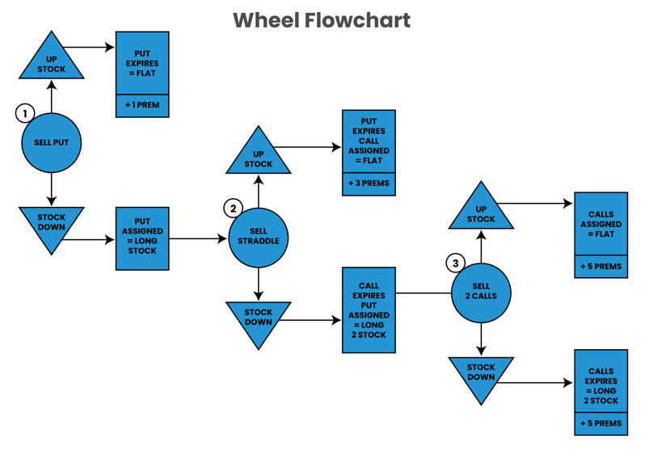
© Copyright. Options Trading IQ. All Rights reserved.
4
Notes:
4

Slide 5
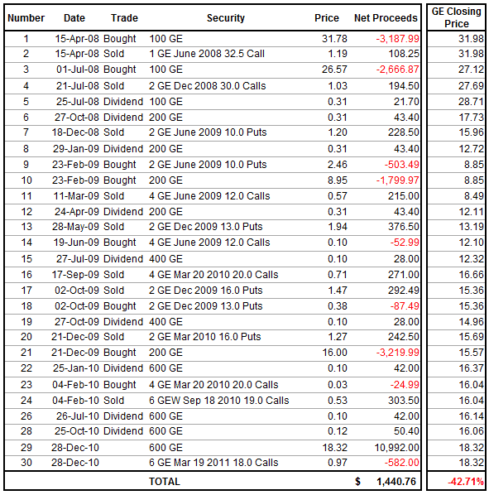
© Copyright. Options Trading IQ. All Rights reserved.
5
Notes:
5

Slide 6
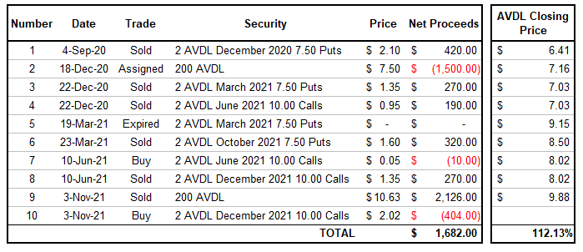
© Copyright. Options Trading IQ. All Rights reserved.
6
Notes:
6

Slide 7
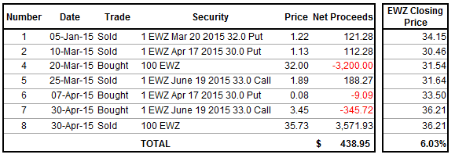
© Copyright. Options Trading IQ. All Rights reserved.
7
Notes:
7

Slide 8
THANK YOU!
www.optionstradingiq.com
© Copyright. Options Trading IQ. All Rights reserved.

