Slide 1

MARCH 2024 OPTIONS INCOME
MASTERY
www.optionstradingiq.com
© Copyright. Options Trading IQ. All Rights reserved.

Slide 2
DISCLAIMER
Options Trading IQ Pty Ltd (ACN 658941612) is a Corporate Authorised Representative (001296496) of Network Influencer Pty Ltd (AFSL 282288). Under these authorisations, Options Trading IQ is authorised to provide general financial product advice in respect of certain classes of financial products, which include securities and derivatives. Any financial product advice provided is general advice only and does not take into account your objectives, financial situation and needs. You should obtain investment advice from a licensed investment adviser before making any investment decisions. Options Trading IQ provides educational courses, this may include the supply of factual information and general advice about securities and derivatives products. Securities and Derivatives trading involves a high level of risk and may not be suitable for all investors. Past performance is not indicative of future results.
Any information contained in this presentation is for educational purposes only. Neither Options Trading IQ Pty Ltd or Gavin McMaster are licensed financial advisors, registered investment advisors, or registered broker dealers. Neither do they provide investment advice, financial advice or make investment recommendations and they are not in the business of transacting trades. Nothing in this communication constitutes a solicitation, recommendation, promotion, endorsement or offer to buy or sell by Options Trading IQ Pty Ltd or Gavin McMaster of any particular security, transaction or investment.
Any trades and / or results covered in this presentation may or may not be live trades.
All trades and trading results are believed to be accurately presented. However, since the trades may not have been executed in the market, the results may have been under or over compensated for the impact, if any, of certain market factors such as liquidity, slippage and commissions. Therefore there can be no guarantee of accuracy or completeness.
No representation is being made that any portfolio will, or is likely to achieve profits or losses similar to those shown.
The risk of loss in trading securities and options in particular can be substantial. Customers must consider all relevant risk factors, including their own personal financial circumstances, before making any financial transaction. Options involve risk and are not suitable for all investors. See the Options Disclosure Document: Characteristics and Risks of Standardized Options, available from www.optionstradingiq.com/risks
© Copyright. Options Trading IQ. All Rights reserved.

Slide 3
SESSION 1 REVIEW
Getting Good Fills
Finding Trade Ideas / Tools I Use
Using MA’s and Money Flow
Selling Cash Secured Puts / The Wheel
Setting Up A Trading Review System
Live Case Studies
© Copyright. Options Trading IQ. All Rights reserved.
3
Notes:
3

Slide 4
TODAY
Trading With Small Accounts
Delta Hedging
Case Study Update & New Case Studies
Volatility
Iron Condors
Directional Credit Spreads
Delta Dollars
© Copyright. Options Trading IQ. All Rights reserved.
4
Notes:
4

Slide 5
SMALL ACCOUNT
Don’t Give Up
Highly Liquid Stocks – SPY, AAPL, IWM
Risk Defined Strategies Only
Backtesting
Start Small – Get The Process Right
© Copyright. Options Trading IQ. All Rights reserved.
5
Notes:
5

Slide 6
Volatility
Volatility is a massive topic, and I could spend a whole week on it, but let’s focus on some of the most important aspects.
“Volatility” can refer to a few different things. Firstly, a stock has historical volatility and implied volatility.
Historical volatility measures how much the stock has moved in the past. It’s a known thing.
Implied volatility is unknown, because it is the market’s estimate of how volatile the stock will be in the future.
We don’t know this, so market makers estimate how much they think the stock will move over the next 7, 30, 60 days etc.
© Copyright. Options Trading IQ. All Rights reserved.
6
Notes:
6

Slide 7
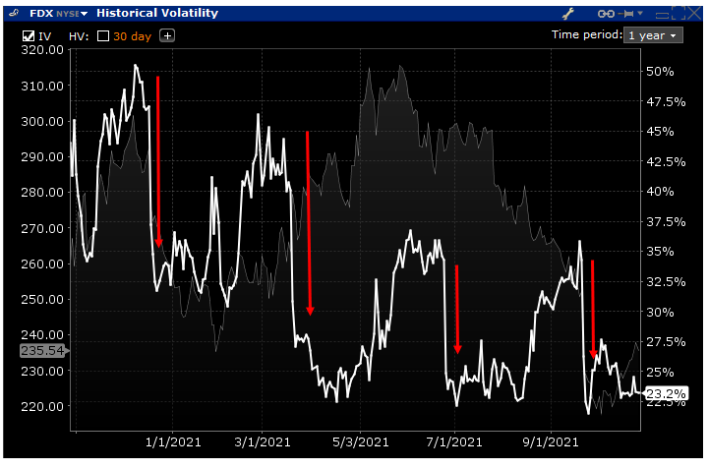
Volatility
Volatility is high when there is a big event coming up, like earnings. Once earnings have passed, volatility drops down again because the uncertainty has been removed.
© Copyright. Options Trading IQ. All Rights reserved.
7
Notes:
7

Slide 8
Volatility
As well as the stock having a general level of IV, every single option strike will have its own level of IV.
Generally, the further out in time we go, the higher the implied volatility. This is because with more time, there is more chance that something bad can happen.
This is called Contango.
Let’s look at some examples.
© Copyright. Options Trading IQ. All Rights reserved.
8
Notes:
8

Slide 9
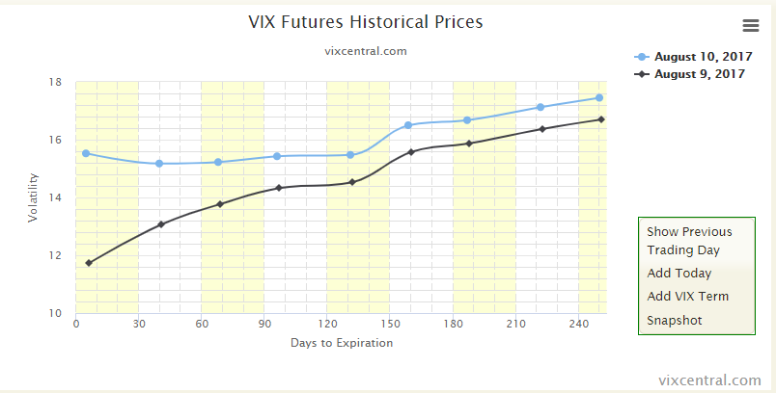
Volatility
© Copyright. Options Trading IQ. All Rights reserved.
9
Notes:
9

Slide 10
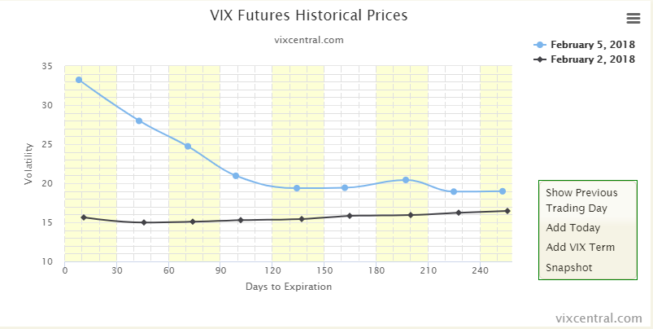
Volatility
© Copyright. Options Trading IQ. All Rights reserved.
10
Notes:
10

Slide 11
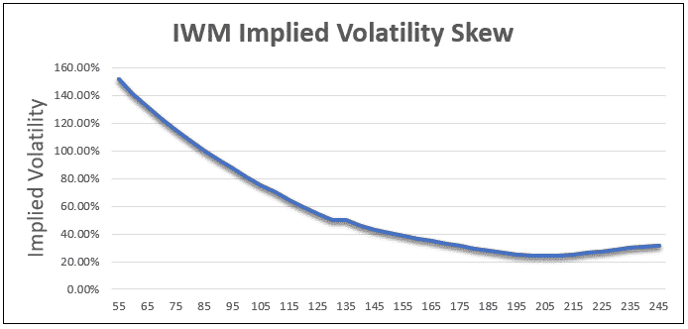
Volatility Skew
As well as volatility being different through time (horizontal skew), it can also be different across strikes (vertical skew).
Generally, implied volatility is high for far OTM puts, because people are willing to pay more for “crash protection”.
This is especially true for the Russell 2000 index which tends to fall severely during market corrections.
© Copyright. Options Trading IQ. All Rights reserved.
11
Notes:
11

Slide 12
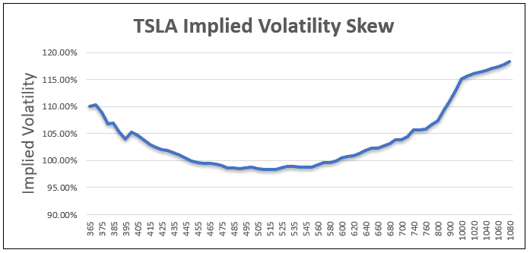
Volatility Skew
OTM puts having high volatility is not always the case. Here we see TSLA volatility which is skewed to the upside.
This is because traders were aggressively buying OTM calls to try and profit from the rising stock price.
© Copyright. Options Trading IQ. All Rights reserved.
12
Notes:
12

Slide 13
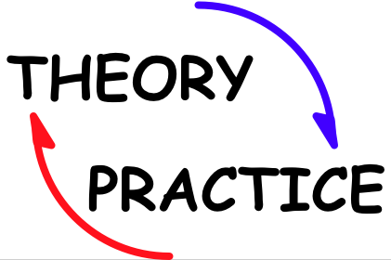
© Copyright. Options Trading IQ. All Rights reserved.
13
Notes:
13

Slide 14
THANK YOU!
www.optionstradingiq.com
© Copyright. Options Trading IQ. All Rights reserved.

