Slide 1

VOLATILITY TRADING DOMINATION
www.optionstradingiq.com
© Copyright 2017. Options Trading IQ. All Rights reserved.

Slide 2
DISCLAIMER
Any information contained in this presentation is for educational purposes only. Neither IQ Financial Services, LLC or Gavin McMaster are licensed financial advisors, registered investment advisors, or registered broker dealers. Neither do they provide investment advice, financial advice or make investment recommendations and they are not in the business of transacting trades. Nothing in this communication constitutes a solicitation, recommendation, promotion, endorsement or offer to buy or sell by IQ Financial Services, LLC or Gavin McMaster of any particular security, transaction or investment.
Any trades and / or results covered in this presentation may or may not be live trades.
All trades and trading results are believed to be accurately presented. However, since the trades may not have been executed in the market, the results may have been under or over compensated for the impact, if any, of certain market factors such as liquidity, slippage and commissions. Therefore there can be no guarantee of accuracy or completeness.
No representation is being made that any portfolio will, or is likely to achieve profits or losses similar to those shown.
The risk of loss in trading securities and options in particular can be substantial. Customers must consider all relevant risk factors, including their own personal financial circumstances, before making any financial transaction. Options involve risk and are not suitable for all investors. See the Options Disclosure Document: Characteristics and Risks of Standardized Options, available from www.optionstradingiq.com/risks
© Copyright 2017. Options Trading IQ. All Rights reserved.

Slide 3
OUTLINE
Trading Volatility
Option Volatility Explained
Why Is It Important
Delving In To The VIX
© Copyright 2017. Options Trading IQ. All Rights reserved.
Notes:
3

Slide 4
OPTION VOLATILITY EXPLAINED
Option volatility is a key concept for option traders and even if you are a beginner, you should try to have at least a basic understanding.
Option volatility is reflected by the Greek symbol Vega, which represents an options sensitivity to changes in implied volatility.
All else being equal (no movement in share price, interest rates and no passage of time), option prices will increase if there is an increase in volatility and decrease if there is a decrease in volatility.
Therefore, it stands to reason that buyers of options (those that are long either calls or puts), will benefit from increased volatility and sellers will benefit from decreased volatility.
© Copyright 2017. Options Trading IQ. All Rights reserved.
4
Notes:
4

Slide 5
OPTION VOLATILITY EXPLAINED
Here is a theoretical example to demonstrate the concept:
Let's look at a stock priced at $50. Consider a 6-month call option with a strike price of $50:
If implied volatility is 90, the option price is $12.50
If implied volatility is 50, the option price is $7.25
If implied volatility is 30, the option price is $4.50
© Copyright 2017. Options Trading IQ. All Rights reserved.
5
Notes:
5

Slide 6
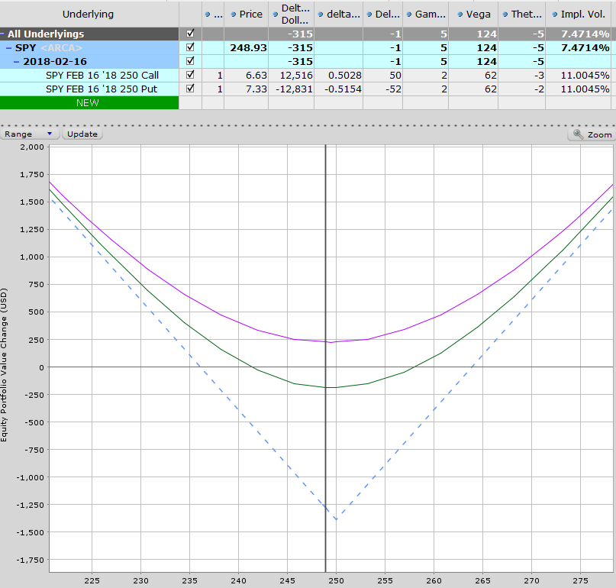
PRACTICAL EXAMPLE
Below we have an SPY Long Straddle. The purple line indicates P&L if volatility rises 15% and the green line is if volatility drops 15%.
© Copyright 2017. Options Trading IQ. All Rights reserved.
6
Notes:
6

Slide 7
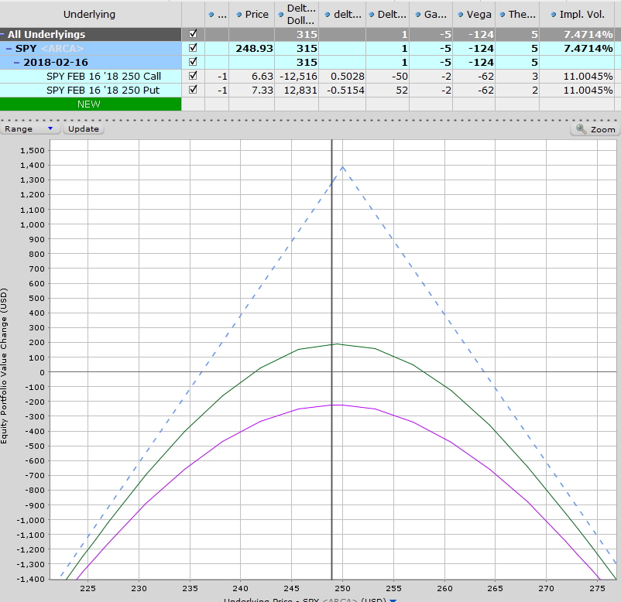
PRACTICAL EXAMPLE
The opposite is true for the trader who has an SPY Short Straddle. The purple line indicates P&L if volatility rises 15% and the green line is if volatility drops 15%.
7
Notes:
7

Slide 8
WHY IS IT IMPORTANT?
One of the main reasons for needing to understand option volatility, is that it will allow you to evaluate whether options are cheap or expensive by comparing Implied Volatility (IV) to Historical Volatility (HV).
Implied Volatility is an estimate of the volatility that will occur in the future (unknown). Historical volatility measure the level of volatility from the past (known).
© Copyright 2017. Options Trading IQ. All Rights reserved.
8
Notes:
8

Slide 9
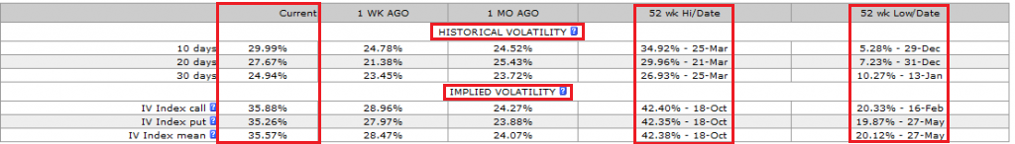
WHY IS IT IMPORTANT?
Below is an example of the HV and IV for AAPL. You can see that at the time, AAPL’s HV was between 25-30% for the last 10-30 days and the current level of IV is around 35%.
This shows that traders were expecting big moves in AAPL going forward.
You can also see that the current levels of IV, are much closer to the 52 week high than the 52 week low. This indicates that this was potentially a good time to look at strategies that benefit from a fall in IV.
© Copyright 2017. Options Trading IQ. All Rights reserved.
9
Notes:
9

Slide 10
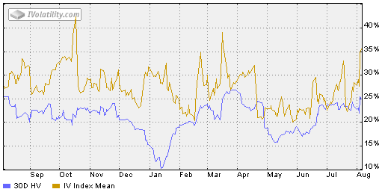
WHY IS IT IMPORTANT?
Here is the same information shown graphically. You can see there was a huge spike in mid-October. This coincided with a 6% drop in AAPL stock price.
Drops like this cause investors to become fearful and this heightened level of fear is a great chance for options traders to pick up extra premium via net selling strategies such as Iron Condors.
Generally when you see IV spikes like this, they are short lived, but be aware that things can and do get worse, such as in 2008, so don’t just assume that volatility will return to normal levels within a few days or weeks.
© Copyright 2017. Options Trading IQ. All Rights reserved.
10
Notes:
10

Slide 11
TRADING VOLATILITY
Trading Volatility may sounds difficult at first, but when you break it down to 1 key factor, it becomes much easier:
BUY LOW, SELL HIGH
You want to be long volatility (positive Vega) when implied volatility is low and you want to be short volatility (negative Vega) when implied volatility is high.
© Copyright 2017. Options Trading IQ. All Rights reserved.
11
Notes:
11

Slide 12
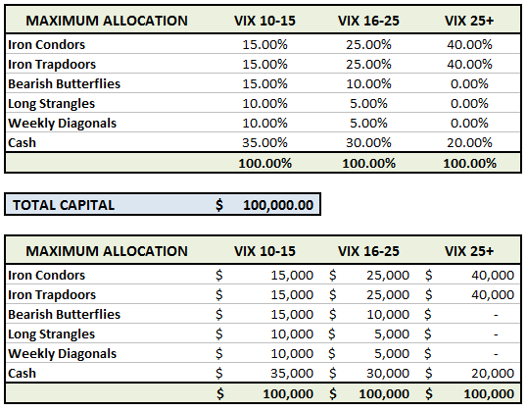
TRADING VOLATILITY
Traders can set up rules for trade allocation based on Volatility levels. The below allocations, skew trading strategies towards short volatility strategies when volatility is high and long volatility strategies when volatility is low.
© Copyright 2017. Options Trading IQ. All Rights reserved.
12
Notes:
12

Slide 13
VOLATILITY SKEW
Not all volatility is created equal. Each option strike has its own implied volatility.
Volatility skew can occur across different strikes within the same expiry month.
It can also occur on options with the same strike price, but different expiry months.
© Copyright 2017. Options Trading IQ. All Rights reserved.
13
Notes:
13

Slide 14
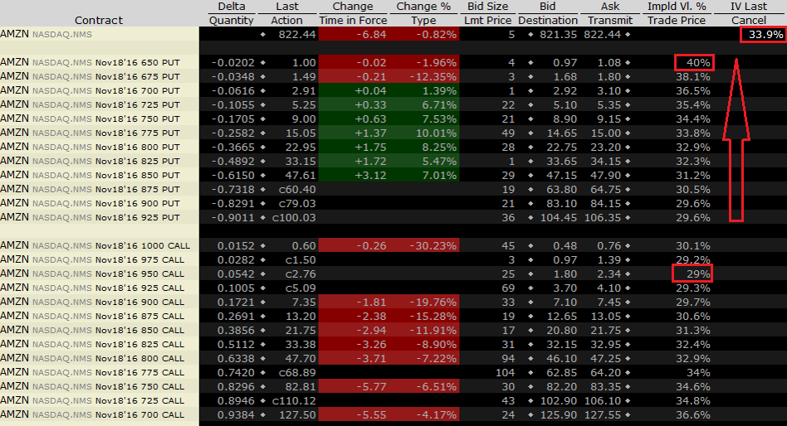
VOLATILITY SKEW
Here we’re looking at AMZN volatility. The IV for the stock is 33.9%, but the IV for the individual strikes within the Nov 18th, 2016 expiry month vary from 29.2% to 40%.
© Copyright 2017. Options Trading IQ. All Rights reserved.
14
Notes:
14

Slide 15
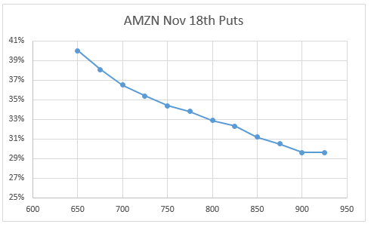
VOLATILITY SKEW
Here is the IV Skew for the puts shown graphically.
© Copyright 2017. Options Trading IQ. All Rights reserved.
15
Notes:
15

Slide 16
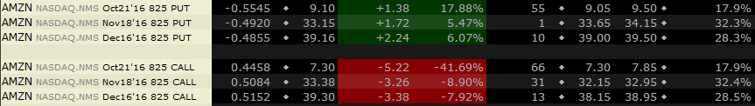
VOLATILITY SKEW
Volatility skew also occurs through different expiry months. Looking again at Amazon, these at-the-money strikes have vastly different implied volatility.
Why is that?
Amazon’s earnings date is October 27th.
© Copyright 2017. Options Trading IQ. All Rights reserved.
16
Notes:
16

Slide 17
VIX DERIVATIVES
We cannot trade the VIX directly, but there are a number of derivatives available to investors, some better than others. One of the issues with VIX derivatives is that none of them can track the VIX index exactly. They can’t track the exact performance of the VIX because they only allow investors to bet on the future value of the VIX rather than its current value. Here is a list of some of the major VIX related products that are now available for trading:
VXX – iPath S&P 500 VIX Short Term Futures TM ETN
VXZ – iPath S&P 500 VIX Mid-Term Futures ETN
TVIX – VelocityShares Daily 2x VIX Short Term ETN
XIV - VelocityShares Daily Inverse VIX Short Term ETN
UVXY – ProShares Trust Ulta VIX Short-Term Futures ETF
SVXY – ProShares Short VIX Short-Term Futures ETF
© Copyright 2017. Options Trading IQ. All Rights reserved.
17
Notes:
17

Slide 18
VIX DERIVATIVES
Some of these VIX related products have been incredibly popular, with trading volumes going through the roof.
However, despite the increase in volume, the general public’s understanding of these VIX derivatives seems to be minor at best at non-existent at worst.
To paraphrase a popular Warren Buffet quote, “only invest in things you understand”.
Don’t ask me why but some people love to buy and hold VXX hoping to profit from a volatility spike.
© Copyright 2017. Options Trading IQ. All Rights reserved.
18
Notes:
18

Slide 19
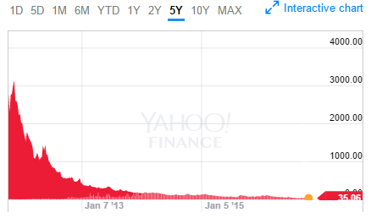
VIX DERIVATIVES
Looking at this chart how profitable do you think holding VXX has been in the long term??
Looking Even the term sheet for the product says, "If you hold your ETN as a long-term investment, it is likely that you will lose all or a substantial portion of your investment." Wow, sounds great, where do I sign up!!
© Copyright 2017. Options Trading IQ. All Rights reserved.
19
Notes:
19

Slide 20
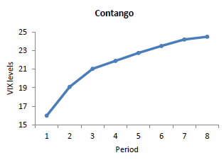
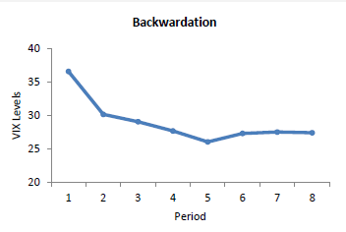
VIX DERIVATIVES
So while ETN’s such as VXX, VXZ and TVIX are increasing in popularity, they are not designed to be buy and hold investments.
Anyone considering doing so should have their head examined. The reason for this is the cost of rolling the futures to maintain a constant maturity date.
To understand this, we first need to understand a little about contango and backwardation.
20
Notes:
20

Slide 21
CONTANGO
Contango is a term stemming from the futures market, which reflects the most common condition of the market.
Contango is when long dated futures are higher than short dated futures. In the futures market this reflects the cost of carry, which would represent the costs of holding and paying for storage of a commodity.
The further out in time you go, the higher the storage costs will be, hence the higher the price for the commodity future.
Cost of carry on financial instruments would be the cost of financing the position, e.g. interest rate expense rather than storage expense.
© Copyright 2017. Options Trading IQ. All Rights reserved.
21
Notes:
21

Slide 22
CONTANGO
Contango occurs with VIX futures as well. When the VIX is very low, the expectation is that it will rise again at some point in the future, back up towards the mean.
In this case, long dated VIX futures will be more expensive than short dated futures.
© Copyright 2017. Options Trading IQ. All Rights reserved.
22
Notes:
22

Slide 23
BACKWARDATION
So if we have contango when the VIX is low, what do we have when the VIX is high?
Basically the opposite scenario whereby the short dated futures are more expensive than the long dated futures.
This is known as backwardation. The expectation is that while markets are volatile now, they will settle down in the future and “revert to the mean”.
© Copyright 2017. Options Trading IQ. All Rights reserved.
23
Notes:
23

Slide 24
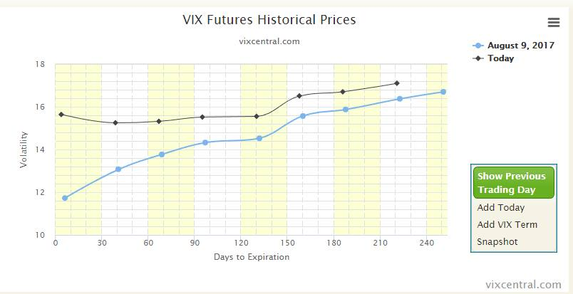
REAL LIFE EXAMPLE
On August 10th 2017, stocks sold off heavily and the VIX Futures Curve went from Contango into Backwardation.
© Copyright 2017. Options Trading IQ. All Rights reserved.
24
Notes:
24

Slide 25
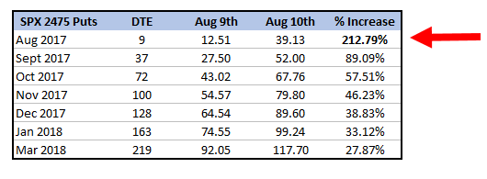
REAL LIFE EXAMPLE
The other important concept to keep in mind with implied volatility is that not all options are impacted equally.
Using the previous example of the August 10th VIX spike, we see some interesting data. The shorter term options were impacted far more than the longer term options. Yet another reason to avoid weekly Condors!
© Copyright 2017. Options Trading IQ. All Rights reserved.
25
Notes:
25

Slide 26
USING VIX DERIVATIVES
Hopefully by now you have got the point never to hold on to these instruments as a volatility hedge for more than 1-2 days at most.
There are better ways to hedge a portfolio than buying and holding this junk.
Given that instruments like VXX and UVXY have lost 99% of there value and will continue to do so, it could be argued that shorting these instruments is the way to go.
But, you need to have balls of steel. If volatility does spike, these things can jump 100, maybe even 200%. You would not want to outright short them.
© Copyright 2017. Options Trading IQ. All Rights reserved.
26
Notes:
26

Slide 27
USING VIX DERIVATIVES
However, a better strategy might be to use option spreads to limit the risk.
Here’s a recent trade I place in UVXY. On Sept 12th VIX opened at 20.13 having been as low as 11.65 two trading day before (73% jump). SPX dropped from 2,185 to 2118
UVXY opened at 22.92 having been as low 16.77 two days prior.
I sold a November 20-25 Bear Call Spread for $1.30
11 trading days later, VIX had dropped back to 12.97 and UVXY had dropped to 16.38. I closed the spread for $0.71
© Copyright 2017. Options Trading IQ. All Rights reserved.
27
Notes:
27

Slide 28
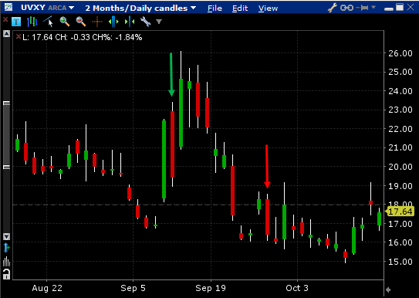
USING VIX DERIVATIVES
Maximum risk in the trade: $370 per contract
Profit: $59 per contract
Percentage Gain: 15.95%
© Copyright 2017. Options Trading IQ. All Rights reserved.
28
Notes:
28

Slide 29
USING VIX DERIVATIVES
Here is another idea when it comes to hedging our short volatility trades. This is something that is frequently done by professional traders. E.g.
Sell 1 VIX Dec 19th $12 Put @ $0.80
Buy 1 VIX Dec 19th $15 Call @ $1.80
Sell 2 VIX Dec 19th $25 Calls @ $0.65
Net Credit: $30
© Copyright 2017. Options Trading IQ. All Rights reserved.
29
Notes:
29

Slide 30
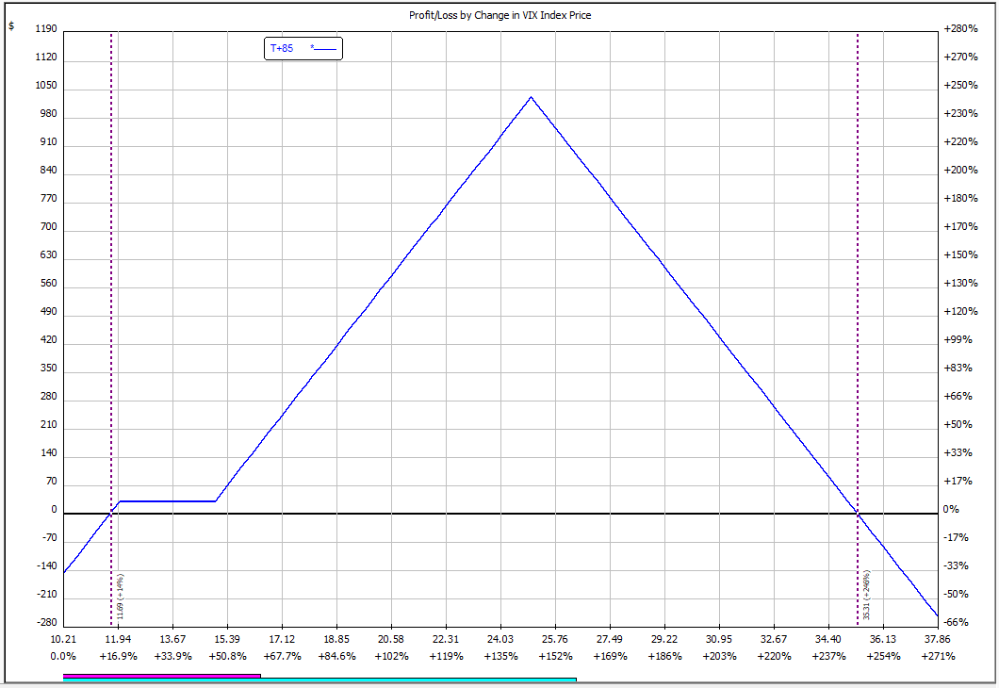
USING VIX DERIVATIVES
The trade loses if VIX settles below 11.70 or above 35.30. Anything in between is in the profit zone.
© Copyright 2017. Options Trading IQ. All Rights reserved.
30
Notes:
30

Slide 31
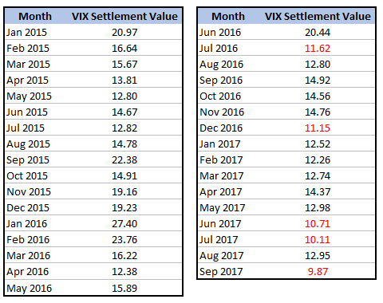
USING VIX DERIVATIVES
VIX settlement prices can be found at:
http://www.cboe.com/data/historical-options-data/index-settlement-values
© Copyright 2017. Options Trading IQ. All Rights reserved.
31
Notes:
31

Slide 32
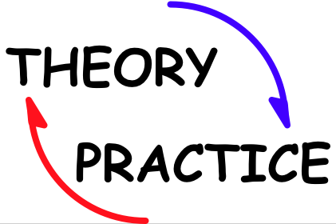
USING VIX DERIVATIVES
© Copyright 2017. Options Trading IQ. All Rights reserved.
32
Notes:
32

Slide 33
THANK YOU!
www.optionstradingiq.com
© Copyright 2017. Options Trading IQ. All Rights reserved.

