Slide 1

APRIL 2025 OPTIONS INCOME
MASTERY
www.optionstradingiq.com
© Copyright. Options Trading IQ. All Rights reserved.

Slide 2
DISCLAIMER
Options Trading IQ Pty Ltd (ACN 658 941 612) is a Corporate Authorised Representative (CAR No. 001312737) of Point Capital Group Pty Ltd (ACN 625 931 900), holder of Australian Financial Services Licence (AFSL No. 518031).
Under these authorisations, Options Trading IQ Pty Ltd is authorised to provide general financial product advice only in respect of certain classes of financial products, including securities and derivatives. All information and advice provided is of a general nature and does not take into account your personal objectives, financial situation or needs. You should consider whether the information is appropriate to your circumstances and seek advice from a licensed financial adviser before making any investment decisions.
Options Trading IQ Pty Ltd provides educational courses that may include factual information and general advice about securities and derivatives products. The content is for educational purposes only and is not intended to provide, nor should it be relied upon as, personal financial advice or a recommendation to trade or invest in any financial product.
Trading in securities and derivatives involves significant risk and may not be suitable for all investors. Past performance is not indicative of future results. You should carefully consider your financial circumstances and consult a qualified financial adviser before engaging in securities or derivatives trading.
All trades and trading results are believed to be accurately presented. However, since the trades may not have been executed in the market, the results may have been under or over compensated for the impact, if any, of certain market factors such as liquidity, slippage and commissions. Therefore there can be no guarantee of accuracy or completeness.
No representation is being made that any portfolio will, or is likely to achieve profits or losses similar to those shown.
The risk of loss in trading securities and options in particular can be substantial. Customers must consider all relevant risk factors, including their own personal financial circumstances, before making any financial transaction. Options involve risk and are not suitable for all investors. See the Options Disclosure Document: Characteristics and Risks of Standardized Options, available from www.optionstradingiq.com/risks
© Copyright. Options Trading IQ. All Rights reserved.

Slide 3
OUTLINE
Getting Good Fills
Finding Trade Ideas / Tools I Use
Using MA’s and Money Flow
Selling Cash Secured Puts / The Wheel
Setting Up A Trading Review System
Live Case Studies
© Copyright. Options Trading IQ. All Rights reserved.
3
Notes:
3

Slide 4
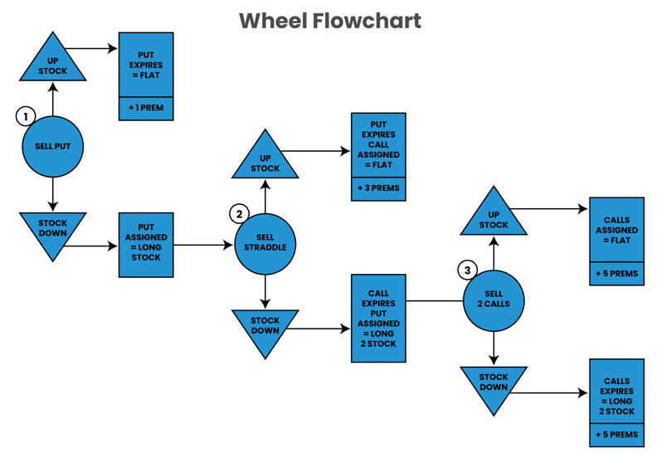
© Copyright. Options Trading IQ. All Rights reserved.
4
Notes:
4

Slide 5
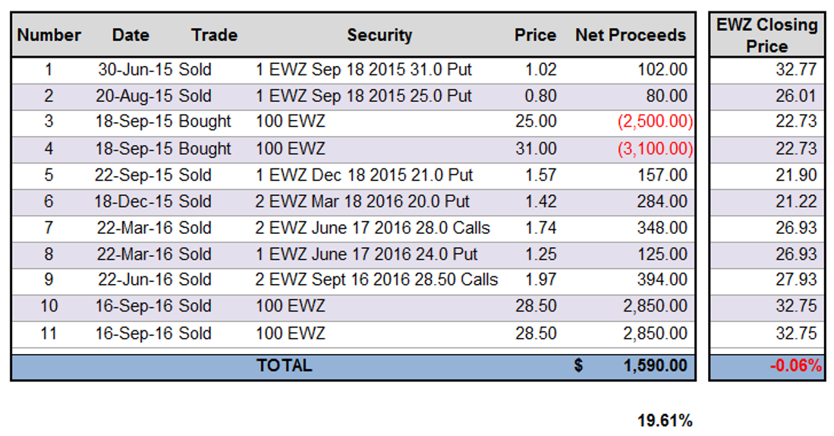
© Copyright. Options Trading IQ. All Rights reserved.
5
Notes:
5

Slide 6
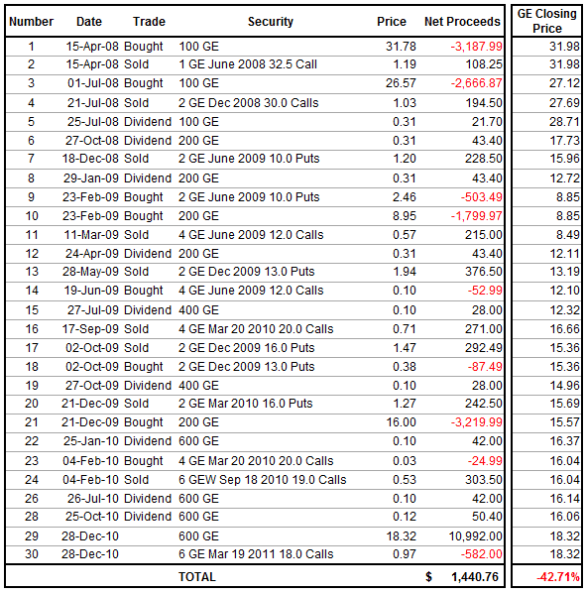
© Copyright. Options Trading IQ. All Rights reserved.
6
Notes:
6

Slide 7
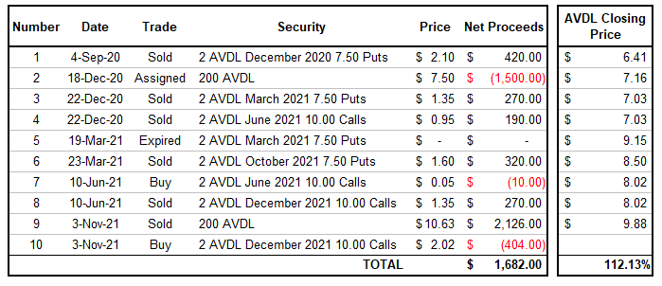
© Copyright. Options Trading IQ. All Rights reserved.
7
Notes:
7

Slide 8
THANK YOU!
www.optionstradingiq.com
© Copyright. Options Trading IQ. All Rights reserved.

